Slide 1
PRINCIPLES OF ECONOMICS
(HS3002D)

Slide 2
YOUR THOUGHTS………
WHAT IS AN ECONOMY?
WHAT IS ECONOMICS ALL ABOUT?
IS ECONOMICS A SCIENCE?
WHY STUDY ECONOMICS?
Even to earn a Nobel Prize in Economics!!!

Slide 3
Firms
Individuals (producers / consumers)
Government
Participants in Economics
Institutions
Transnational stakeholders
Countries

Slide 4
SCOPE OF ECONOMICS………
Branches of Economics Science
Macroeconomics
Microeconomics
Deals with the economy as a whole
Nation income, inflation, price levels
Earlier form of Economics
Deals with individual choices
Utility, profit, and costs optimization
Marginalism as the guiding principle

Slide 5
COURSE CONTENT………
UNIT 1 CHAPTER 1: TEN PRINCIPLES OF ECONOMICS
UNIT 2 CHAPTER 2: THINKING LIKE AN ECONOMIST
UNIT 3 CHAPTER 3: INTERDEPENDENCE AND GAINS FROM TRADE
UNIT 4 CHAPTER 4: THE MARKET FORCES OF SUPPLY AND DEMAND
UNIT 5 CHAPTER 5: ELASTICITY AND ITS APPLICATION
UNIT 6 CHAPTER 6: SUPPLY, DEMAND, AND GOVERNMENT POLICIES
UNIT 7 CHAPTER 7: CONSUMERS, PRODUCERS, AND THE EFFICIENCY OF MARKETS

Slide 6
COURSE CONTENT………
UNIT 8 CHAPTER 8: APPLICATION: THE COSTS OF TAXATION
UNIT 9 CHAPTER 13: THE COSTS OF PRODUCTION
UNIT 10 CHAPTER 14: FIRMS IN COMPETITIVE MARKETS
UNIT 11 CHAPTER 15: MONOPOLOY
UNIT 12 CHAPTER 16: MONOPOLISTIC COMPETITION
UNIT 13 CHAPTER 17: OLIGOPOLOY
UNIT 14 CHAPTER 23: MEASURING A NATION’S INCOME
UNIT 15 CHAPTER 24: MEASURING THE COST OF LIVING
UNIT 16 CHAPTER 29: THE MONETARY SYSTEM

Slide 7
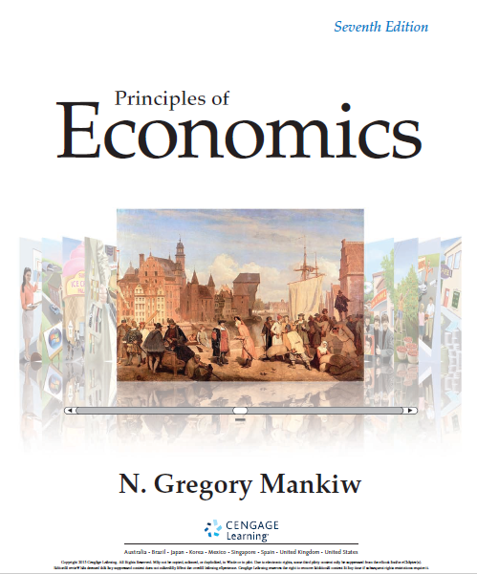
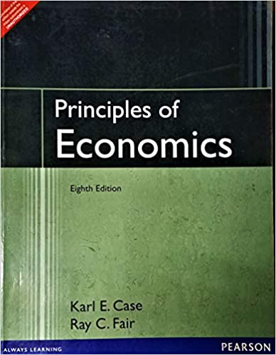
TEXTBOOKS TO FOLLOW………

Slide 8
EVALUATION COMPONENTS………
CONTINUOUS EVALUATION 50 MARKS
Internal Exam 1 [20 MARKS]
Internal Exam 2 [20 MARKS]
Assignment 1 [10 MARKS]
TERM EVALUATION 50 MARKS
CLASS DISCUSSION USING INDIAN EXAMPLES

